Slide 1
Life cycle of a Plant

Slide 2
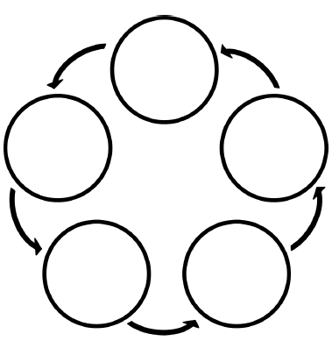
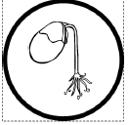
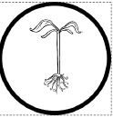
Put the pieces of the life cycle of a plant in the correct order. After you have completed the assignment turn it in.

